Slide 1
Project – Reduce Cycle Time to Report RTE Numbers
D
M
A
I
Submitted By
Thulasiram Ruppa Krishnan
MBC 638 – Data Analysis and Decision Making
C

Slide 2
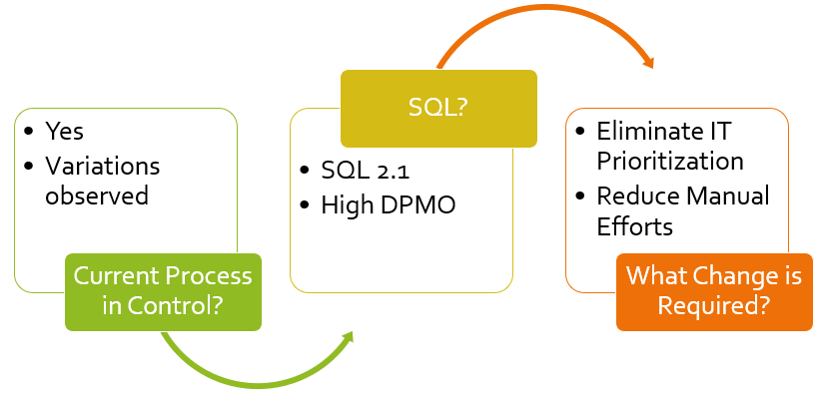
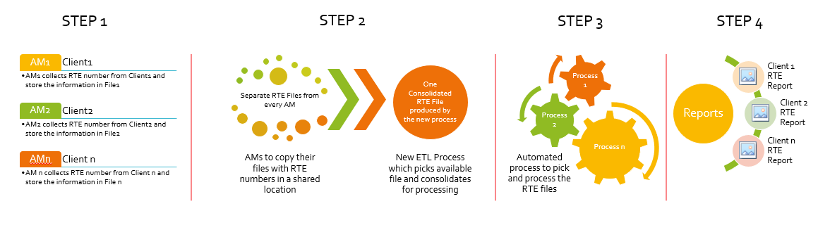
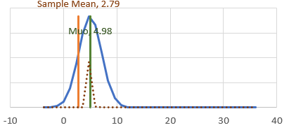
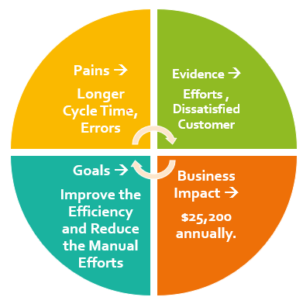
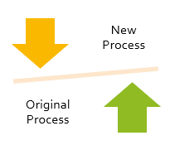
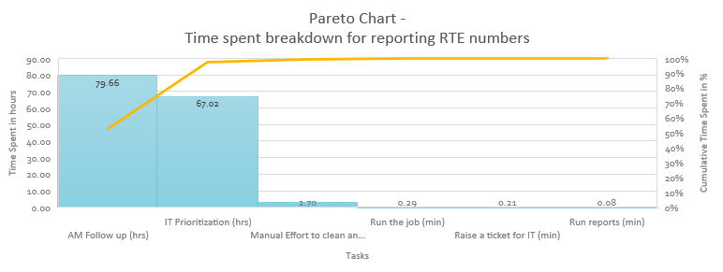
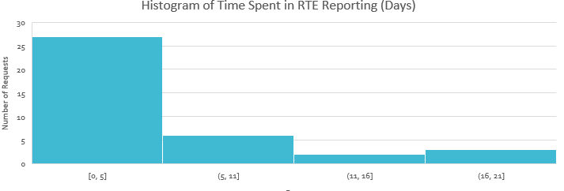
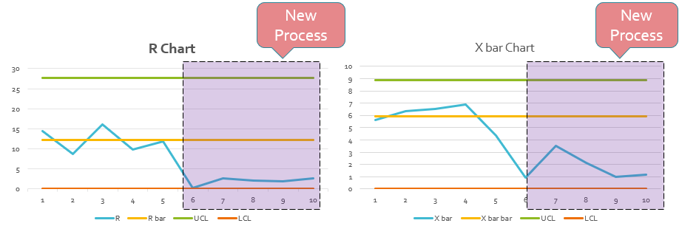
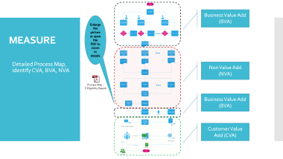
MBC 638 – Data Analysis and Decision Making
Project – Reduce Cycle Time to Report RTE Numbers
Process Owner – Thulasiram Ruppa Krishnan
Key Dates →
Team Launch 9/1
Define 16/1
Measure 6/2
Analyze 2/20
Improve 3/6
Control 3/17
DEFINE
Problem Statement
MEASURE
Process Map is derived Identified CVA, BVA, NVA
Efforts are Measured
ANALYZE
CONTROL IMPROVE
Today, my company is receiving eligibility numbers from RTE clients through account managers every month. Account managers will then enter these numbers in a common spreadsheet located in a sharepoint. This spreadsheet is then downloaded, formatted and uploaded in EDW for Reporting by IT. The manual steps involved in downloading, formatting and uploading the numbers to EDW which is time consuming, error prone and more effort intensive operation.
Implemented a Solution and the new process flow is measured
SQL is improved from 2.1 to 2.8
Control Charts are in place to
stay alert
New Process
Alternate Hypothesis Proved
$25,200 Saved Annually
Descriptive Statistics and Histogram derived

Slide 3
PROJECT PLAN
Define
Identify the problem and scope.
Complete Problem Definition Worksheet
Measure
Process Map, identify CVA, BVA, NVA
Measure effort required for each step in the process map
Analyze
Analyze Data
Improve
Determine Root causes
Control
Identify and implement process improvements
Verify improvements through SQL & other tools
Put a control plan in place; ensure the problem stays fixed.
Prepare Control Charts to stay Alert
Week 1
Week 2,3,4
Week 5,6
Week 7,8
Week 9,10

Slide 4
DEFINE
A) Problem Statement
Today, my company is receiving eligibility numbers from RTE clients through account managers every month. Account managers will then enter these numbers in a common spreadsheet located in a sharepoint. This spreadsheet is then downloaded, formatted and uploaded in EDW for Reporting by IT. The manual steps involved in downloading, formatting and uploading the numbers to EDW which is time consuming, error prone and more effort intensive operation.
Pains:
Same spreadsheet is maintained by different Account Managers causing manual errors due to overwriting or incorrect entry against wrong client
Information is received from clients at different point in time causing multiple file processing and uploads in a month
Account managers need to enter a request in ticketing system for the IT to process causing delay in the process and increase in the cycle time of RTE numbers availability for reports
Time intensive manual effort is involved in formatting and uploading the spreadsheet to EDW for IT
Errors are not captured and investigating any issues in the spreadsheet is a pain
Evidence:
Incorrect eligibility numbers identified by clients in the report.
Number of tickets raised by account managers to upload RTE spreadsheet.
Efforts spent by IT to upload RTE spreadsheet

Slide 5
DEFINE Contd..
B) Business Impact:
We have a need to fix this problem because of the following business impacts
Incorrect and late reporting to our clients represents error prone and inefficient process that we have in place and affects company’s reputation.
These numbers are also responsible for billing our clients and incorrect billing will end up losing a client and failure to meet contractual agreement
It is costing about on an average of 84 requests/year * 1.5 hours/request * $200/hour IT cost = $25,200 (84*1.5*200) annually.
Benefits
Improved cycle time for the availability of RTE numbers in reports
Savings in effort and cost by reducing manual efforts and not losing clients due to incorrect reporting
Success Criteria:
Reduce the manual efforts required by IT team per request
Reduce the manual efforts from account managers by submitting and tracking a every request in system
Reduce and Identify errors occurred in the manual entry by account managers
Key Output
Saving in Dollar (Y) is the key output here
Y = Savings from the IT effort + Savings from AM effort + Saving by preventing a client from losing the business

Slide 6
DEFINE Contd..
C) Goals:
My Goal is to
Reduce the manual efforts required by IT team from 1.5 hours per request to 0 hours per request by creating an efficient process to handle the data and upload to EDW.
Eliminate the intermediate step required by account managers by entering and tracking the request in ticketing system.
Identify and report errors to Account managers automatically through the process without involving manual intervention
D) Project Scope:
The scope of this project is limited to IT operations involved in the process. Here are the steps where IT is involved in the entire process
Receive and update the ticketing system before beginning the IT operation
Download the spreadsheet from sharepoint
Format the data which is suitable for uploading into EDW
Copy the formatted data in a file move to an internal server location
Run the RTE process to import the file data into EDW
Monitor the process and verify the uploaded data after successful completion
Update the ticketing system and send it back to account manager for them to run the respective report.
Out of scope is collection and manual entry of RTE numbers from various clients by account managers. We don’t have a control on when the numbers are made available by account managers from our clients. Also, any wrong information entered by the account managers are out of scope since we don’t have any control on that.

Slide 7
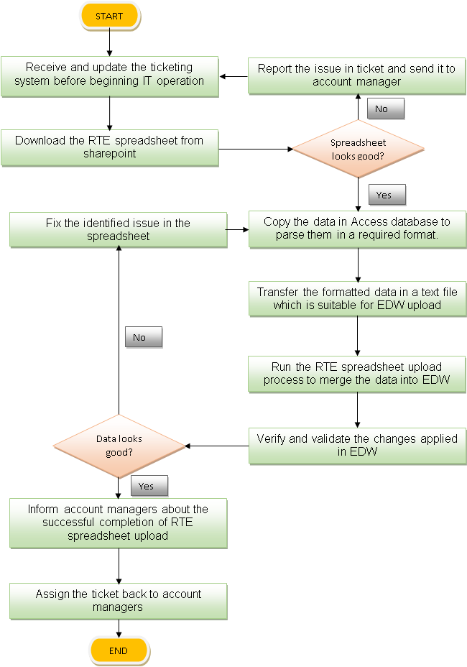
DEFINE Contd..
E) Team:
My Company IT team is the owner of this process. As I am part of the IT team handling these requests, I can do the analysis and identify the impacts of this process.
I can reach out to other team members in IT and account managers if any suggestions or improvement is required.
G) Process Map:

Slide 8
DEFINE Contd..
Thought Process Map:
Reduce Cycle Time for Reporting RTE numbers
Why is it taking longer to report RTE numbers
What can we do to reduce the cycle time?
What is the business impact?
Identify steps/stakeholders involved
Identify BVA and NVA
How to estimate business impact
Client Submission, Account Mangers Follow-up, IT Prioritization, Developer Efforts, Communication, Wait times, Run Jobs, Create Reports etc..
Can we eliminate NVA from the process
Find revenue for every client
AM – Follow up
2- 3 days is a NVA step?
IT Prioritization
2- 3 days is a NVA step?
Is it possible to lose client?
Which is most time consuming?
What is our bottleneck ?
Find business impacts
Find business impacts
Find past escalations and lost client and revenue
Required for the business and it is BVA
Not required for the business and it is NVA
Lost few clients in the last Quarter
Find estimated time for each step, Pareto Chart
Find waste
AM – Follow up 2- 3 days
IT Prioritization
2- 3 days
IT Wait Time

Slide 9
Business Value Add (BVA)
Enlarge the picture or open the PDF to zoom in details
MEASURE
Detailed Process Map, identify CVA, BVA, NVA
Non Value Add (NVA)
Business Value Add (BVA)
Customer Value Add (CVA)

Slide 10
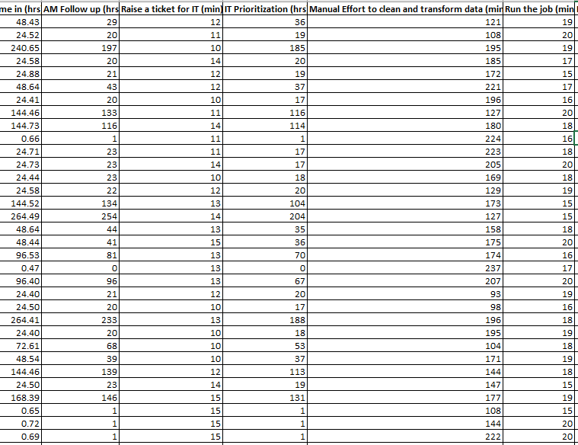
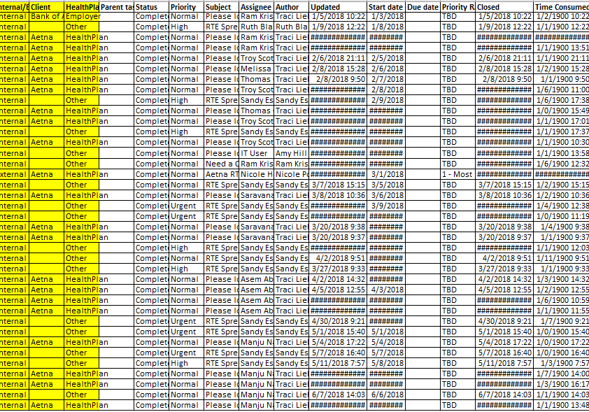
MEASURE Contd..
Table 1.2
The ticketing system enables us to capture and measure the time taken by the individual steps involved in the life cycle of RTE reporting (Table 1.2)
Identified and collected data from the ticketing system
Measure effort required for each step in the process map
The ticketing system captures the individual step in the life cycle of data collected from the account managers until it is finally reported (Table 1.1)
Table 1.1

Slide 11
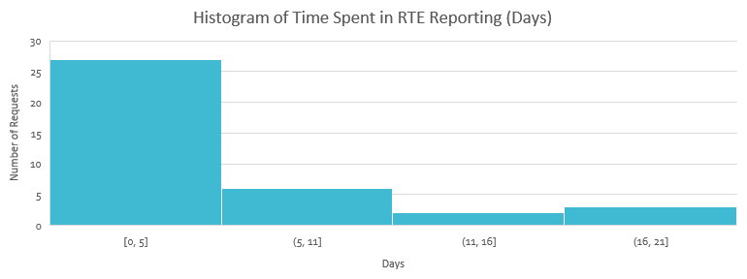
MEASURE Contd..
Measure Dispersion by drawing histogram on actual time took to complete RTE reporting request
Calculate Description Statistics on actual time took to complete RTE reporting request
Actual Time spent
Mean | 4.980565363
Standard Error | 0.829495567
Median | 2.397688368
Mode | #N/A
Standard Deviation | 5.113354091
Sample Variance | 26.14639006
Kurtosis | 1.091550912
Skewness | 1.388137572
Range | 19.03190307
Minimum | 0.146087963
Maximum | 19.17799103
Sum | 189.2614838
Count | 38

Slide 12
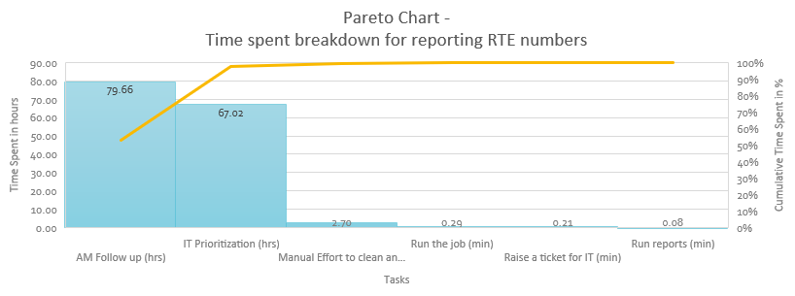
ANALYZE
Tasks | Time Spent in hours
AM Follow up (hrs) | 79.66
Raise a ticket for IT (min) | 0.21
IT Prioritization (hrs) | 67.02
Manual Effort to clean and transform data (min) | 2.70
Run the job (min) | 0.29
Run reports (min) | 0.08
Analyze Data and determining input’s (x) impact on the output (y).
Top 80 % of the Effort Spent is due to the below two major tasks
AMs involved in collecting data and following up with client to get the data. This step is a BVA and cannot be eliminated and out of scope for this project
IT Prioritization in order to process the collected information to produce reports. This step is NVA and can be eliminated with potential improved solution in place

Slide 13
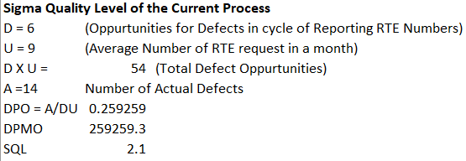
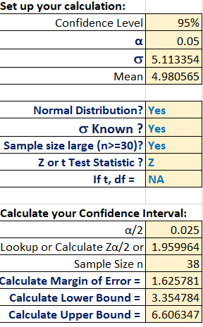
ANALYZE Contd..
Calculate the SQL of the current process. We can compare the SQL of current process with that of improve process to determine if the improvement is significant
Calculate the confidence Interval of the collected data

Slide 14
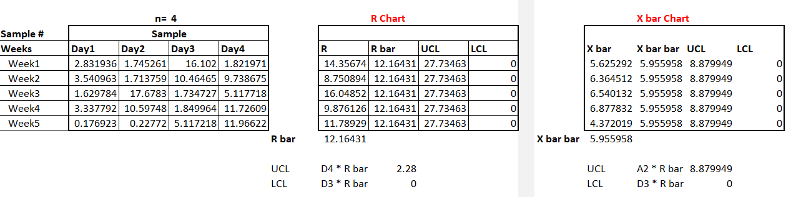
ANALYZE Contd..
Plot the control chart to check if the current process in control. Also this will help to detect in determining if the new process shows improvement by extending the UCL , LCL and Rbar, X bar bar
For plotting R Chart and X bar Chart, I took 4 samples in each week from Week1 till Week5 of the current process

Slide 15
IMPROVE – Implement a solution for eliminating NVA from the process
STEP 1
STEP 2
Process n
Process 2
Process 1
STEP 3
STEP 4
Reports
Client 1 RTE Report
Client 2 RTE Report
Client n RTE Report
AM1
Client1
AM1 collects RTE number from Client1 and store the information in File1
AM2
Client2
AM2 collects RTE number from Client2 and store the information in File2
AMn
Client n
AM n collects RTE number from Client n and store the information in File n
Separate RTE Files from every AM
AMs to copy their files with RTE numbers in a shared location
One Consolidated RTE File produced by the new process
New ETL Process which picks available file and consolidates for processing
Automated process to pick and process the RTE files
In the new improved process , I eliminated the IT Prioritization and Manual effort to clean up the data to process the RTE numbers from the spreadsheet of information entered by Account Managers (AM).
This reduced the cycle time which is responsible for IT prioritization which took considerable amount of time in total cycle time

Slide 16
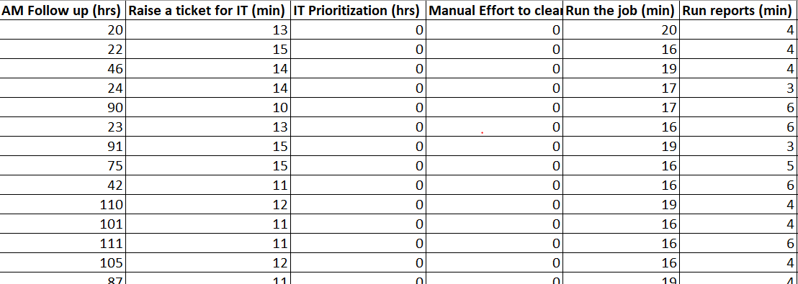
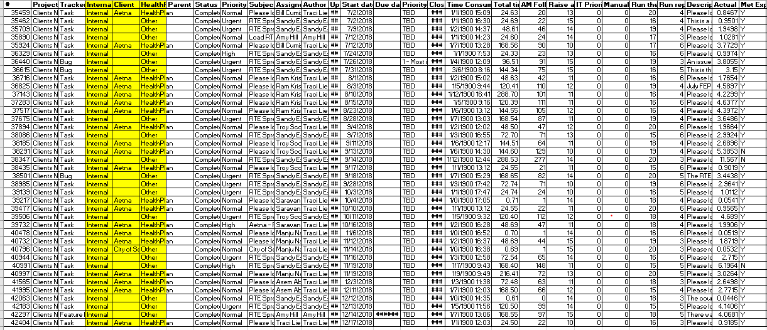
IMPROVE Contd..
In the new process, there is no need of ticketing system , whenever the AMs are ready with their RTE numbers they need to copy the files automatically by the process and processed
But I still used the ticketing system and tickets are directly assigned to the IT Developer just to track the time spent on the business process and it helps to gauge the improvement.
Table 1.3 shows the data collected on the improved process . Hours spent for IT prioritization and the Manual efforts are brought down to zero by eliminating these steps from the original process
Table 1.3

Slide 17
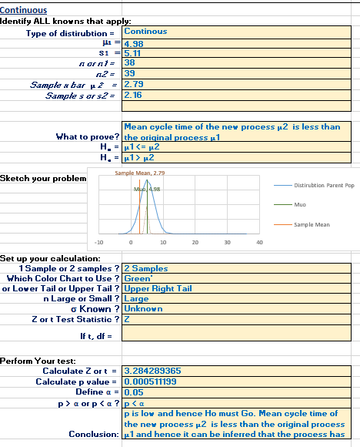
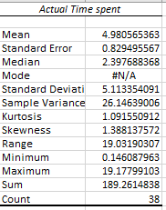
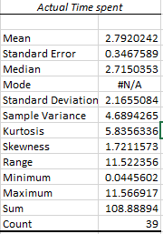
Hypothesis Testing Null Hypothesis Ho → µ1 <= µ2 , There are no changes observed between the sample S1 (Original Process) and S2 (New Process), mean cycle time of the new process is same as original process Alternate Hypothesis Ha → µ1 > µ2 , Mean cycle time of the new process is less than the original process which inference the process has improved .
IMPROVE Contd..
Sample1
Sample2
Hypothesis Test

Slide 18
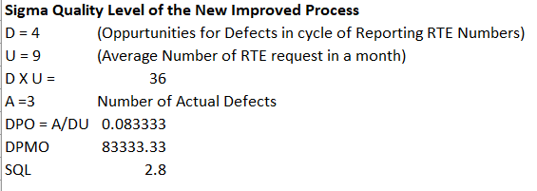
CONTROL
Calculate the SQL of the New process and compare with the SQL of original process to determine if the process is improved
SQL of the old process is 2.1 and the SQL of the new process is 2.8 which confirms that the process has improved
New Process
Original Process
SQL 2.1
SQL 2.8

Slide 19
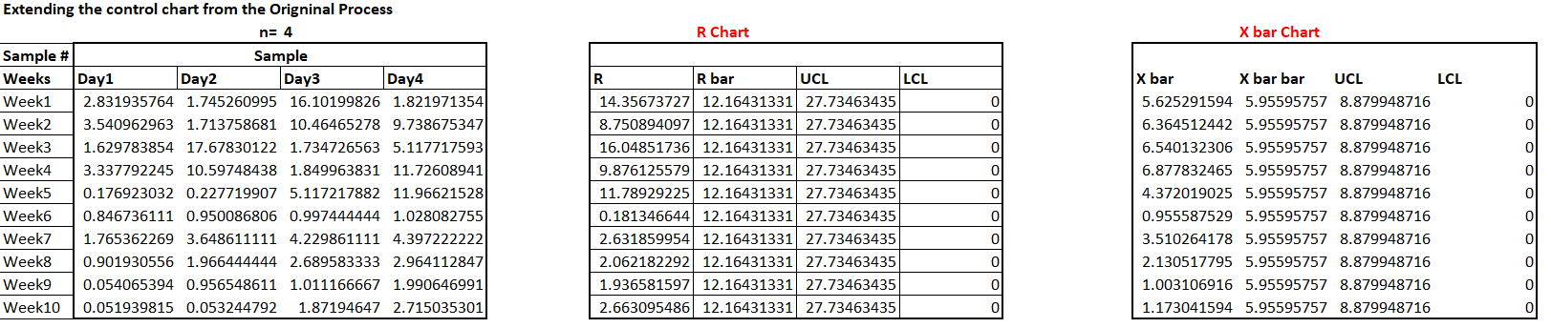
CONTROL Contd..
Put a control plan in place; ensure the problem stays fixed.
Control Charts
Control charts are plotted to stay alert and signal if there is a potential issue in the process
Also, Here the control charts which are extended from the original control limits showing the process improved has improved and in control
New Process
New Process

